Slide 1
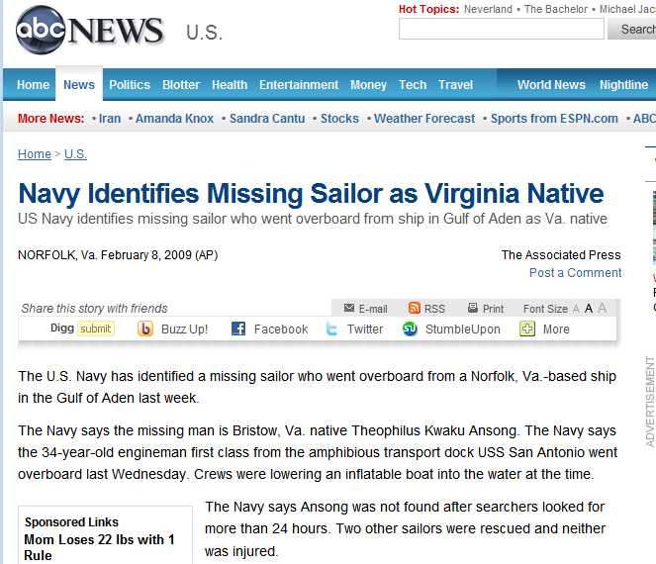

Slide 2

Just imagine:
You go over board in dawn, moderately heavy weather.
You have a life jacket and common „Personal locator beacon“, an EPIRB, with you.
In that bad situation you are cool, because you know you can be rescued by the coastguard. Aren´t you?

Slide 3
Dammed, the coast is about 200 miles away and the water is cold. How long will they need to find and to pick me up??????
But, where is my boat – why do they not rescue me??????
Don´t they see me?????? – I have an EPIRB!?
Right, but unfortunately the crew has no clue where you are, the coastguard might have, but they are too far away…….

Slide 4
Wouldn´t it be great to have a unit which shows the live-position“ of the castaway to:
the own ship
and if possible
to the other ships around
and if possible
to the coast guard and other authorities?
reliable and free of charge?

Slide 5
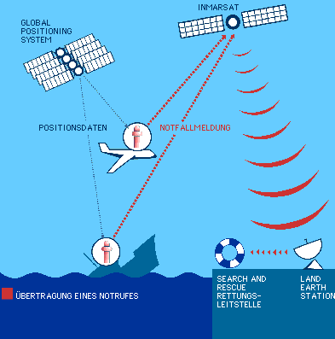
TODAY:
Propietary EPIRB system works with the alert telegrams on a frequency which can only be seen from authorities
Rescue is initiated, but unfortunately can not on aid workers to be where they are needed!
It may be a long, sometimes pass for too long time until the one is at the MOB position.

Slide 6
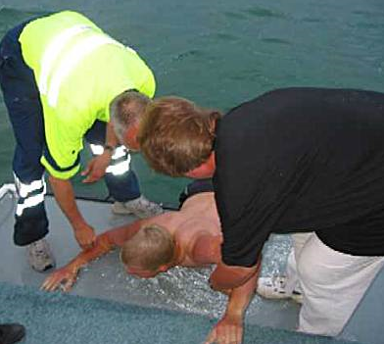
TOMORROW:
Common AIS system works with the alert telegrams on a frequency which can be seen and interpreted by every AIS equiped ship.
In addition to the regulatory agencies and the commercial shipping, this is also a growing number of private recreational craft.
That is, quick and life-sustaining assistance can be realized!

Slide 7
Comparision to other actual S.A.R.T systems
Pos | SART System | Description | Technology | Satellite sytem | Signal noted by |  |  |  |  | Monthly cost for service | Size of unit | Average market price | Note
 |  |  |  |  | Authorities | Appropiate network, commercial | Commercial vessels | Pleasure boaters with AIS | Own boat who lost "passenger"
1 | EPIRB | emergency position indicating radio beaco | 406MHZ, someones Position by GPS, someones postion by 121MHz homing (121MHz phased out in future | GPS, COSPAS/SARSAT | Yes | No | No | No | No | none | big (like a 17oz cola bottle) | 750USD
2 | SPOT | Personal satellite messager | 406MHz, Position by GPS | GPS, Globalstar | only over commercial network (GEOS International Emergency Response Center) | Yes | No | No | No | min 8,50USD | small | 180USD | without service no functionality
3 | Propietray MOB systems | MOB systems | Free common frequency, No GPS position | None | No | No | No | No | Yes, but no "live position" | none | very small | 300USD | No "live" position of lost passenger
5 | Radar S.A.R.T | Homing device based on Radar reflection | Active radar reflection, 9 GHz | None | Yes | No | Maybe | No | Maybe | none | big (like a 17oz cola bottle) | 900USD | recognition range relatively low, inheavy conditions almost "zero"
4 | easyRESCUE "AIS S.A.R.T." | Save and rescue based on AIS technology | AIS, Position by GPS | GPS, None | Yes | partly | Yes | Yes | Yes | none | small | t.b.d.

Slide 8
easyRESCUE feature highlights:
Intention is, to use the “easyRESCUE” for pleasure boaters, but also for commercial applications as well as for the military.
That means, that there are some very specific and detailed requests must be fulfilled!
Wherever people can find themselves in distress and rapid assistance is thus life sustaining.
To all these groups to meet, of course, certain profiles are met.

Slide 9
There are plenties, but these are the most challenging requests :
                Operation temperature: -20°C to 85°C
                Fully operational at -20°C for 96h with GPS reception and AIS signal
Waterproof in 10m depth for 5min, afterwards fully functional
20m drop to water without damages
More than 3nm transmission range.
floatable
Lifetime batteries minimum 3 years also with self-discharge

Slide 10
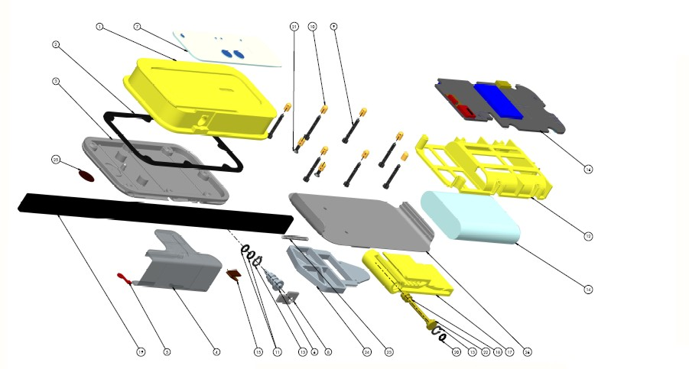
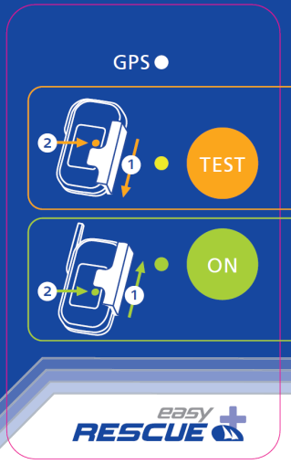
The easyRESCUE
Note:
First sketch of 3D Modell
Size a little bit bigger than a Iphone (Length and Width similar, depth app. 35mm)
Labelsize app. 1:1

Slide 11
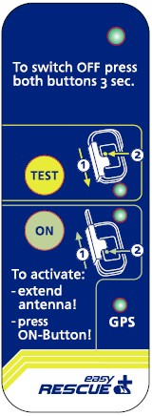
Lable size 1:1
Anmerkung: 3D Modell
Size a little bit bigger than a Iphone
(Length and Width similar, depth app. 35mm)

Slide 12
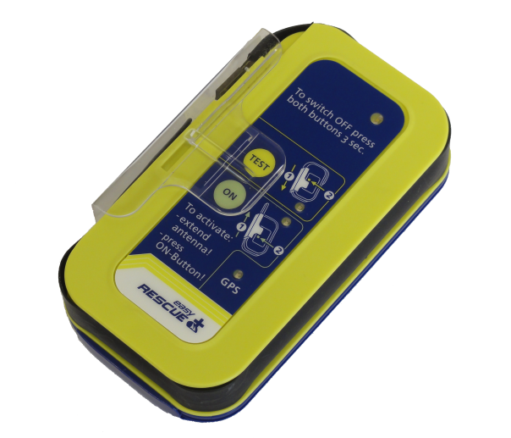
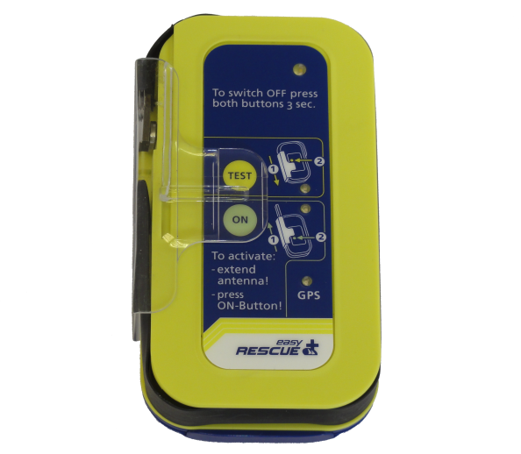
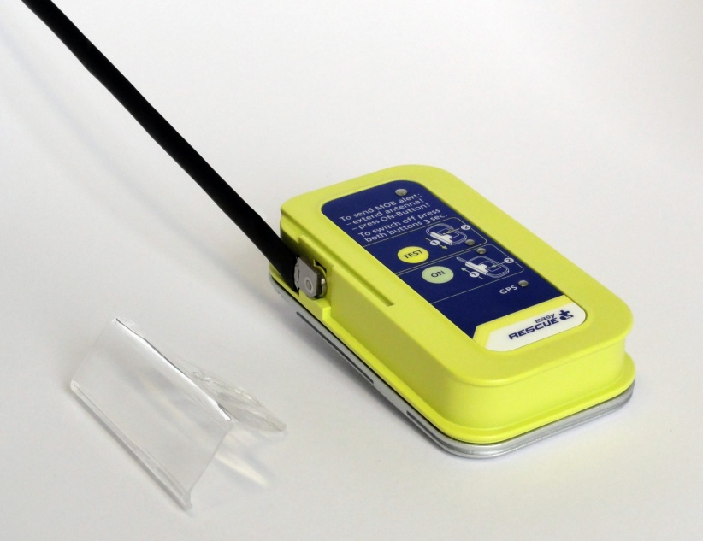
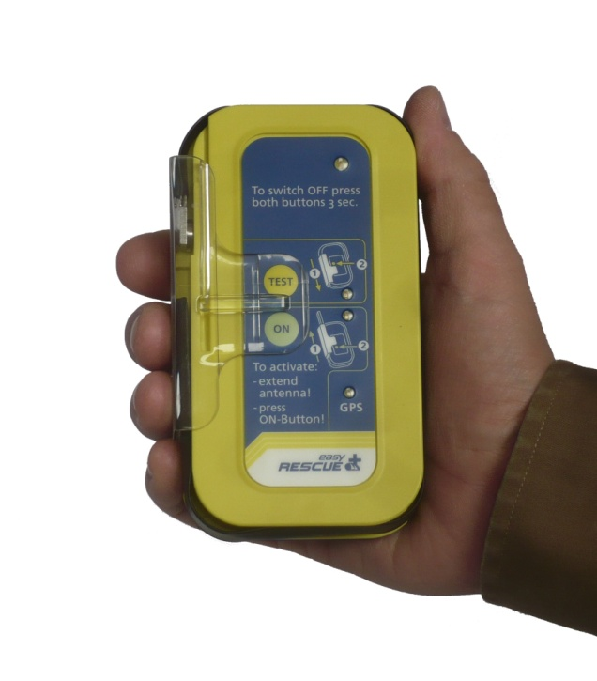

Slide 13
FAQ‘s
What channels do the easyRESCUE use in the FM radio?
The easyRESCUE is based on the AIS-system. AIS will use the channels 80 and 81. These channels are blocked in the normal FM radio, as there are data channels. It broadcasts on the frequency 161,975 Mhz and 162,025 Mhz.
How long will the batteries of the easyRESCUE last?
With an annual test, the batteries last 4 years and within this period, we ensure 96 hours air time from initiation of the easyRESCUE.

Slide 14
FAQ‘s
How far the signal of the easyRESCUE will be seen?
With appropriate conditions, the signal can be widely seen 2-3 miles. This value obviously depends strongly on the external conditions.
How the easyRESCUE can be attached to the body?
The attachment of the easyRESCUE done with either a belt clip or a lanyard.

Slide 15
FAQ‘s
How buoyant is the easyRESCUE?
The easyRESCUE is fully amphibious. Like an iceberg, the transmitter and signal part out of the water tower, while the rest is under the water surface.
How is the useability of the easyRESCUE? 1)How can it lead in? 2)How can it be turned off again? 3)Does it trigger automatically?
1)The easyRESCUE has a 2-stage trigger. First, a slide must be pushed through a breaking point. Then the activation by pressing the ON button.
2)By simultaneously pressing the buttons ON and TEST for 3 seconds.
3)No, there is no automatical trigger. The easyRESCUE has to be lead in personally.

Slide 16
FAQ‘s
Which chartplotter or pc will get the easyRESCUE messages?
All plotters or pc's which are equipted with an AIS-receiver will get the message from the easyRESCUE.
Does my plotter or PC receive data from the easyRESCUE?
Each plotter, which can receive and display AIS data, can also receive and display data from the easyRESCUE.
How does the easyRESCUE look like on chartplotter or pc-screens?
Currently, an activated easyRESCUE appears as a ship icon with a reference AIS SART active.

Slide 17
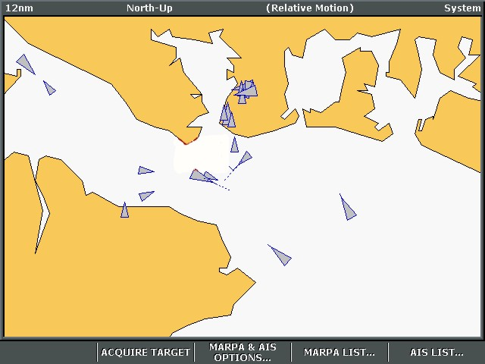
AIS S.A.R.T. active

Slide 18
FAQ‘s
Does The device get its own MMSI?
No, the unit is factory shipped with a manufacturer's MMSI.
Does this MMSI must be reported to the Federal Network Agency?
Yes, the unit must be notified, but not be allowed.

